Slide 1

Department of Electrical and Electronic Engineering
Faculty of Engineering and Technology
University of Dhaka
Performance Study of a Highly Efficient FeS₂ Based Thin‑film Solar Cell Using CuBi₂O₄ as a Back Surface Field Layer
Presented by
Exam Roll No.: 70406
Registration No.: 2013-012-407
Session: 2019-2020

Slide 2
Thin Film Solar Cell (TFSC)
Ferrous Sulphide (FeS₂)
Back Surface Field & Buffer Layer
Proposed Structure
Material & Methodology
Algorithm
Structure Optimization
Result & Discussion
Conclusion & Future Works
Reference
CONTENTS
Department of Electrical and Electronic Engineering
Faculty of Engineering and Technology
University of Dhaka
1/11/2026
2

Slide 3
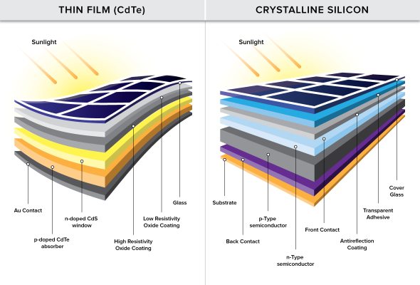
THIN-FILM SOLAR CELL (TFSC)
CdTe, CIGS, CZTS etc. as an absorber in TFSC have emerged as the most attractive materials for photovoltaic technology.
ADVANTAGES:
High efficiency
Fabrication compatibility
Thermal Stability
Suitable Energy gap
Traditional absorber materials in TFSCs still face issues.
PROBLEMS:
Scarcity of resources
High cost of material processing
High cost of device fabrication
Toxicity
Figure 1: Typical TFSC with different Layer [1].
Department of Electrical and Electronic Engineering
Faculty of Engineering and Technology
University of Dhaka
1/11/2026
3

Slide 4
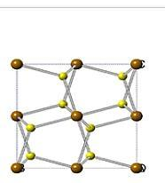
FERROUS SULPHIDE (FeS₂)
FeS₂ can be one of the ideal candidate as an absorber layer in TFSC
( it is also called as “Fool’s Gold” )
PROPERTIES:
High absorbance (10⁵ cm⁻¹, hv > 1.3 eV)
Lattice constant of 5.416 Å
Narrow bandgap of 0.8-0.95 eV
Abundant and Non-toxic
Deposition technique: Sulfurization, Sputting, MBE, CVD, Spin Coating [2].
Figure 2: Crystal Structure of FeS₂ [2].
Department of Electrical and Electronic Engineering
Faculty of Engineering and Technology
University of Dhaka
1/11/2026
4

Slide 5
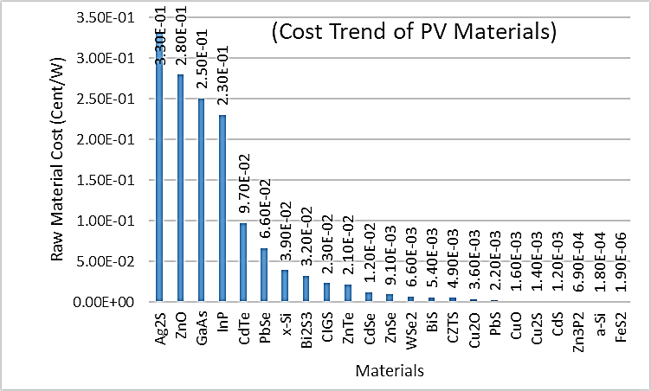
FERROUS SULPHIDE (FeS₂)
“LOW PRODUCTION COST”
(Most Attractive Feature of FeS₂)
Energy for Extraction: 24 kWh/kg for Si vs 2 kWh/kg for FeS₂
Cost of Extraction: $1.70 per kg for Si vs $0.03 per kg for FeS₂ [3]
Figure 3: Price Comparison of Various PV Materials [3].
Department of Electrical and Electronic Engineering
Faculty of Engineering and Technology
University of Dhaka
1/11/2026
5

Slide 6
FERROUS SULPHIDE (FeS₂)
LIMITATION :
Low Open-circuit Voltage (Voc) that does not exceed 200 mV or ∼20% of its band gap leading to a practical efficiency of ~3% [2]
REASONS:
Sulphur vacancies caused by the S dimer (S-S bond length)
Bulk or near surface Non-stoichiometry
Mid gap defects
Thermionic-field emission and Large Dark Current
Metallic like sulfur layer
Department of Electrical and Electronic Engineering
Faculty of Engineering and Technology
University of Dhaka
1/11/2026
6

Slide 7
BACK SURFACE FIELD & BUFFER LAYER
CuBi₂O₄ (Back Surface Field Layer)
PROPERTIES:
Lattice constant of 5.814 Å
Energy band gap of 1.4 to 1.8 eV
Optical absorption coefficient of > 10⁴ cm⁻¹
Non-toxic
Deposition technique: Hydrothermal Synthesis, Pulsed Laser Deposition, CVD, MBE, Spin-coating etc. [4]
GaAs (Buffer Layer)
PROPERTIES:
Lattice constant of 5.653 Å
Energy band gap of 1.424 eV
Non-toxic
High-efficiency
Low cost solar cells
Deposition technique: Sputting, MBE, CVD, Spin Coating etc. [5]
Department of Electrical and Electronic Engineering
Faculty of Engineering and Technology
University of Dhaka
1/11/2026
7

Slide 8
PROPOSED STRUCTURE
Al
Front Contact
FTO
Anti-reflection Coating
GaAs
GaAs
FTO
Buffer Layer
FeS₂
Absorber Layer
CuBi₂O₄
Back Surface Field (BSF) Layer
CuBi₂O₄
FeS₂
Mo
Depletion Region
Back Contact
Glass
Substrate
Figure 4: Proposed Structure FeS₂/CuBi₂O₄ Based Dual Heterojunction Solar Cell.
Figure 5: Band diagram of Proposed FTO/GaAs/FeS₂/CuBi₂O₄ Structure.
Department of Electrical and Electronic Engineering
Faculty of Engineering and Technology
University of Dhaka
1/11/2026
8

Slide 9
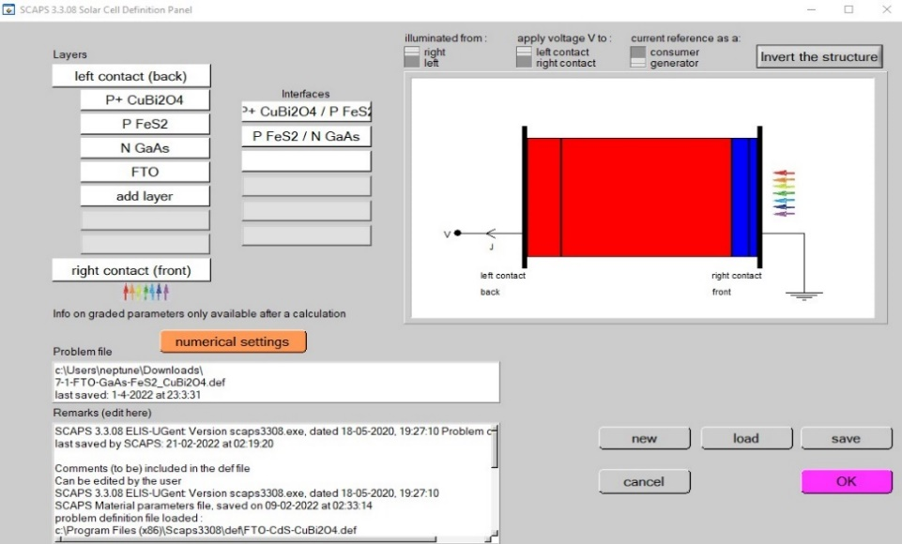
MATERIALS & METHODOLOGY
SCAPS-1D (SOLAR CELL CAPACITANCE SIMULATOR)
FEATURES:
Editable effects and properties of materials
Use of sophisticated equations
Optimization of TFSC
Better description of generation and recombination processes
Real-time band diagram.
Analysis of Different types of defect levels
A variety of standard and other spectra etc
Figure 6: Layer Editing Panel.
Department of Electrical and Electronic Engineering
Faculty of Engineering and Technology
University of Dhaka
1/11/2026
9

Slide 10
ALGORITHM
Design & Propose FeS₂ based solar cell from reviewing literatures
Develop & Validate the model with published experimental data
Launch SCAPS 1D, Set problem, Provide input parameters & Run the program
is the Device Working?
Troubleshoot & Check all Steps
No
Yes
Optimize proposed model
Analyze data & Draw conclusions
Department of Electrical and Electronic Engineering
Faculty of Engineering and Technology
University of Dhaka
1/11/2026
10

Slide 11
STRUCTURE OPTIMIZATION: THICKNESS
Figure 7: Effect on (a) J_{SC}, (b) V_{OC} with the variation of thickness of CuBi₂O₄ for FeS₂ layers.
J_{SC} and V_{OC} are almost invariant with the change of thickness of CuBi₂O₄ for every FeS₂ layer.
J_{SC} increases with the increment of thickness of FeS₂ and becomes constant.
V_{OC} decreases with increment of thickness of FeS₂.
Department of Electrical and Electronic Engineering
Faculty of Engineering and Technology
University of Dhaka
1/11/2026
11

Slide 12
STRUCTURE OPTIMIZATION: THICKNESS
Figure 8: Effect on (c) FF and (d) ɳ with the variation of thickness of CuBi₂O₄ for FeS₂ layers.
Both FF and ɳ increase sightly with the decrement of thickness of CuBi₂O₄.
FF first decreases and then increases with increment of thickness of FeS₂.
ɳ first increases and then slightly decreases with increment of thickness of FeS₂.
Department of Electrical and Electronic Engineering
Faculty of Engineering and Technology
University of Dhaka
1/11/2026
12

Slide 13
STRUCTURE OPTIMIZATION: DOPING CONCENTRATION
Figure 9: Effect on (a) J_{SC}, (b) V_{OC} with the variation of Doping Concentration of CuBi₂O₄ for FeS₂ layers.
J_{SC} and V_{OC} increase with the increment of doping concentration of CuBi₂O₄
J_{SC} and V_{OC} increase sightly with the increment of doping concentration of FeS₂
Department of Electrical and Electronic Engineering
Faculty of Engineering and Technology
University of Dhaka
1/11/2026
13

Slide 14
STRUCTURE OPTIMIZATION: DOPING CONCENTRATION
Figure 10: Effect on (c) FF and (d) ɳ with the variation of Doping Concentration of CuBi₂O₄ for FeS₂ layers.
FF and ɳ increase with the increment of doping concentration of CuBi₂O₄
FF and ɳ first remain constant with the increment of doping concentration of FeS₂
Department of Electrical and Electronic Engineering
Faculty of Engineering and Technology
University of Dhaka
1/11/2026
14

Slide 15
STRUCTURE OPTIMIZATION
Table 1: Optimum Layer Thickness for Proposed Structure.
Table 2: Optimum Doping Profile for Proposed Structure.
Material | Thickness (μm)
GaAs | 0.1
FeS₂ | 0.8
CuBi₂O₄ | 0.2
Material | Donor Doping Density (cm⁻³) | Acceptor Doping Density (cm⁻³)
GaAs | 10¹⁸ | 0
FeS₂ | 0 | 10¹⁷
CuBi₂0₄ | 0 | 3.7×10¹⁸
Department of Electrical and Electronic Engineering
Faculty of Engineering and Technology
University of Dhaka
1/11/2026
15

Slide 16
RESULT & DISCUSSION
Open Circuit Voltage increases significantly in proposed dual heterojunction structure.
Quantum Efficiency also increases significantly in proposed dual heterojunction structure.
Figure 5.13: J-V Characteristics of Optimal Structure.
Figure 5.3: Spectral Response of Optimal Structure.
Department of Electrical and Electronic Engineering
Faculty of Engineering and Technology
University of Dhaka
1/11/2026
16

Slide 17
RESULT & DISCUSSION
Table 3: Device performance of the optimized FeS₂ based solar cells.
PARAMETERS | FeS₂ Absorber Layer | FeS₂/CuBi₂O₄ Absorber Layer | Percentage of Increment
Short Circuit Current Density, J_{sc} (mA/cm²) | 46.349 | 49.64 | 7.1
Open Circuit Voltage, V_{oc} (V) | 0.517 | 0.8426 | 63.67
Fill Factor, FF (%) | 79.58 | 80.0242 | 0.5581
Efficiency, η (%) | 19.1881 | 33.29 | 73.493
Max. Voltage, V_{mmp} (V) | 0.442 | 0.703 | 59.049
Max. Current, J_{mmp} (mA/cm²) | 43.391 | 47.355 | 9.13
Department of Electrical and Electronic Engineering
Faculty of Engineering and Technology
University of Dhaka
1/11/2026
17

Slide 18
RESULT & DISCUSSION
Table 4: Performance of the proposed solar cell in comparison with other solar cells.
No. | Thin Film Solar Cell | V_{OC} (V) | J_{SC} (mA/cm²) | FF (%) | PCE (%) | Type
1. | Si (crystalline) | 0.705 | 42.7 | 82.8 | 25.0 | Experimental
2. | Si (multi-crystalline) | 0.664 | 37.7 | 78.9 | 20.3 | Experimental
3. | CIGS | 0.734 | 39.58 | 80.40 | 23.84 | Experimental
4. | Perovskite | 1.18 | 25.14 | 84.8 | 25.20 | Experimental
5. | CdTe | 0.887 | 31.69 | 78.50 | 22.10 | Experimental
6. | CZTS | 0.716 | 33.7 | 80.3 | 19.4 | Experimental
7. | FeS₂ | 0.842 | 49.64 | 80.0242 | 33.29 | Theoretical
Department of Electrical and Electronic Engineering
Faculty of Engineering and Technology
University of Dhaka
1/11/2026
18

Slide 19
CONCLUSION & FUTURE WORKS
CONCLUSION
Various defects like interface defect, surface recombination etc. will minimize the efficiency.
If 70-80% of simulated result can be found that will be a breakthrough.
FeS₂ can be used as best candidate for absorber using a suitable BSF layer with suitable band alignment.
FUTURE WORKS
In future different materials can be investigated as BSF for increasing the efficiency.
The proposed model may be fabricated in the Laboratory in future.
P-I-N structured FeS₂ may be designed and simulated which is unexplored.
Department of Electrical and Electronic Engineering
Faculty of Engineering and Technology
University of Dhaka
1/11/2026
19

Slide 20
REFERENCE
[1] F. Baig, Y.H. Khattak, S. Ullah, B.M. Soucase, S. Beg, H. Ullah, Numerical analysis a guide to improve the efficiency of experimentally designed solar cell, Appl. Phys. A. 124 (2018) 471. doi:10.1007/s00339-018-1877-x.
[2] Limpinsel, M., Farhi, N., Berry, N., Lindemuth, J., Perkins, C.L., Lin, Q., and Law, M. (2014). An inversion layer at the surface of n-type iron pyrite. Energy Environ. Sci. 7,
1974.
[3] Caba´ n-Acevedo, M., Kaiser, N.S., English, C.R., Liang, D., Thompson, B.J., Chen, H.E., Czech, K.J., Wright, J.C., Hamers, R.J., and Jin, S. (2014). Ionization of high-density deep donor defect states explains the low photovoltage of iron pyrite single crystals. J. Am. Chem. Soc. 136, 17163–17179.
[4] Wang, F.; Septina, W.; Chemseddine, A.; Abdi, F. F.; Friedrich, D.; Bogdanoff, P.; van de Krol, R.; Tilley, S. D.; Berglund, S. P. Gradient Self-Doped CuBi2O4 with Highly Improved Charge Separation Efficiency. J. Am. Chem. Soc. 2017, 139 (42), 15094− 15103.
[5] J. Yin et al., “Charge redistribution at GaAs/P3HT heterointerfaces with different surface polarity,” J. Phys. Chem. Lett., vol. 4, no. 19, pp. 3303–3309, 2013.
[6] Ennaoui, A., Fiechter, S., Pettenkofer, C., Alonso-Vante, N., Bu¨ ker, K., Bronold, M.,
Ho¨ pfner, C., and Tributsch, H. (1993). Iron disulfide for solar energy conversion. Sol. Energy Mater. Sol. Cells 29, 289–370. 2. Ennaoui, A., and Tributsch, H. (1984). Iron sulphide solar cells. Sol. Cells 13, 197–200.
[7] Hossain, J., Mondal, B.K. and Mostaque, S.K., 2021. Design of a highly efficient FeS2-based dual-heterojunction thin film solar cell. International Journal of Green Energy, pp.1-12.
[8] Hosen, A., Mian, M. and Ahmed, S.R.A., 2021. Simulating the performance of a highly efficient CuBi2O4-based thin-film solar cell. SN Applied Sciences, 3(5), pp.1-13.
Department of Electrical and Electronic Engineering
Faculty of Engineering and Technology
University of Dhaka
1/11/2026
20

Slide 21
THANK YOU
Department of Electrical and Electronic Engineering
Faculty of Engineering and Technology
University of Dhaka
1/11/2026
21

Slide 22
Q & A
Department of Electrical and Electronic Engineering
Faculty of Engineering and Technology
University of Dhaka
1/11/2026
22

